Slide 1
Test Plan and Requirement Management

Slide 2
TEST PLAN-Intro
A software project test plan is a document that describes the objectives, scope, approach, and focus of a software testing effort.
The process of preparing a test plan is a useful way to think through the efforts needed to validate the acceptability of a software product.
It identifies test items, the features to be tested, the testing tasks, who will do each task, and any risks requiring contingency Planning.

Slide 3
References for preparing Test Plan
The supporting documents for referring the test plan are:
Project Plan
System Requirements specifications.
High Level design document.
Detail design document.
Development and Test process standards.
Methodology

Slide 4
Test Plan Template
Introduction
Brief introduction of the test strategies, process, workflow and methodologies used for the project
Test scope
In Scope
Scope defines the features, functional or non-functional requirements of the software that will be tested
Out of Scope
Out Of Scope defines the features, functional or non-functional requirements of the software that will NOT be tested

Slide 5
Approach
It gives the overall Testing Approach.
It describes the following details
Are any special tools to be used and what are they?
Will the tool require special training?
What metrics will be collected?
Which level is each metric to be collected at?
How is Configuration Management to be handled?
How many different configurations will be tested?
Hardware
Software
Combinations of HW, SW and other vendor packages

Slide 6
What levels of regression testing will be done and how much at each test level?
Will regression testing be based on severity of defects detected?
How will elements in the requirements and design that do not make sense or are untestable be processed?
Entry & Exit Criteria
Here the test plan should explain as when the testing needs to be started (Entry Criteria) and when the test should be stopped (Exit Criteria)
The idea behind this section is that every process step be inspection, and functional test or Design has a precise entry & exit criteria

Slide 7
Suspension & Resumption Criteria
Suspension criteria specify the criteria to be used to suspend all or a portion of the testing activities
Resumption criteria specifies when testing can resume after it has been suspended.

Slide 8
Example
SUSPENSION CRITERIA | RESUMPTION CRITERIA
Urgent defects, which prevent further testing along any path. | Urgent defects are rectified
Non availability of Test data for scenarios | Test data uploaded in test environment as required to execute scenarios/cases

Slide 9
Test Deliverables
You have to define the list of deliverables which will be delivered from the testing engagement
For example
Test Plan
Traceability Matrix
Test Cases
Test Execution Log
QA Cycle Status Report

Slide 10
Environment Plan
Hardware configuration
For example as mentioned below, this should be the environment which the testers will be performing the test.
This is a very critical section which is an agreement and defining the environment where the testing will be performed
Laptops (Dell) Win XP & Win 2K IE 6.0- Novel Client
Cognizant Desktop compatible to Schering GX260 Win XP IE 6.0
Software Configuration
Home Office Image
Research Image
Active X Control.
Note:
The above mentioned lists are the builds or setup which needs to be deployed in the testers system prior to testing.
If this is not satisfied then the entire test performed by the testers will become invalid

Slide 11
Staffing and Training Needs
Training on the application/system.
Training for any test tools to be used.
The Test Items and Responsibilities sections affect this section. What is to be tested and who is
responsible for the testing and training.

Slide 12
Test Schedule
Specify test milestones
Specify all item transmittal events
Estimate time required to do each testing task
Schedule all testing tasks and test milestones
For each testing resource, specify its periods of use

Slide 13
Risks and Mitigation Plan
Risk detail should be given in the test plan based on the category of the risks the impact will be applied
What are the overall risks to the project with an emphasis on the testing process?

Slide 14
Example:
Lack of personnel resources when testing is to begin.
Lack of availability of required hardware, software, data or tools.
Late delivery of the software, hardware or tools.
Delays in training on the application and/or tools.
Changes to the original requirements or designs.
Complexities involved in testing the applications

Slide 15
Roles & Responsibility
Identify groups responsible for managing, designing, preparing, executing, witnessing, checking and resolving.
Identify groups responsible for providing the test items identified in the Test Items section.
Identify groups responsible for providing the environmental needs identified in the Environmental Needs section

Slide 16
Reference to Templates
This section should give reference to the templates for the following
Test cases
Review check list for Test cases
Test Incident Report
Test Summary Report

Slide 17
Test Case
It is a document which identifies the various tests required to ensure that the system covers all the requirements for the customer.
Test cases follow agreed standard format.(This will be based on the agreed upon format specified in the QAP or as specified in the Standards and Guidelines document)

Slide 18
Test Case Design
Test cases are designed to ensure complete coverage of the software components under different environmental conditions and data inputs
Test cases should exist for checking Performance of various operations e.g. data retrieval and updation, report printing
Test cases should exist for covering error conditions that can occur
Test data should be mentioned explicitly for each test condition

Slide 19
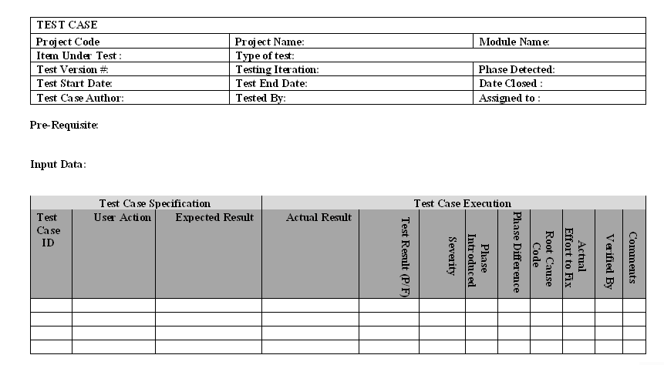
Test Case Template (Standard )

Slide 20
Defect Tracking/Closure
Defect Identified by the Tester
Entry made in the DTS Web by Tester
DTS Web can be accessed by Developers/Testers
Summary of the Defect and Description are entered
Severity is chosen among Fatal/Major/Minor/Suggestion
Priority could be High/Medium/Low
The initial State will be Open

Slide 21
Defect Tracking (Contd...)
Defect Analyzer - Analyses the impact of the Defect
Assigns to the concerned team with person responsible
DA - Informs the concerned person
Further Comments can be given in the Description
DA enters the Phase introduced, detected and Root Cause Codes

Slide 22
Defect Tracking (Contd...)
Assigned team member fixes the defect
On resolution DA changes the defect to Under QC
QC reviews and tests the impacted items
If review ok the defect state is changed to Fixed
Changed files are checked-in to the VSS by CC
If review failed, its again assigned to the concerned team
DA informs the initiator to check for closure of the defect
Initiator confirms the Defect is actually fixed for Closure

Slide 23
Requirement Traceability Matrix(RTM)
One of the key objectives of any testing venture is to ensure that the application under test is behaving as per the functional specification. To ensure this the key objective will be to test all the functionalities or the requirements as it is stated by the customer. Hence Test Coverage becomes a very critical metric for any Testing venture.
Requirement Traceability is very effective tool to ensure the test coverage. Traceability ensures completeness, that all lower level requirements
come from higher level requirements, and that all higher level requirements are allocated to lower level requirements. Traceability is also used to manage change and provides the basis for test planning.

Slide 24
Components
The following components should be mapped using the RTM so that all the test artifacts can be traced:
Test Requirement
Test Strategy
Test Plan
Test Scenario
Test Cases
Defect ids

Slide 25
Types of Traceability Test Matrix
Forward traceability looks at the following:
Tracing the business requirements to their resulting test requirement(s) to ensure the completeness of the product requirement specification.
Tracing each unique test requirement forward into the design or strategy that test that requirement, and the tests that validate that requirement and so on. The objective is to ensure that each requirement is thoroughly tested.
Backwards traceability looks at the following:
Tracing each Test back to its associated requirement. Backward traceability can verify that the requirements have been kept current with tests.
Tracing each requirement back to its source(s).

Slide 26
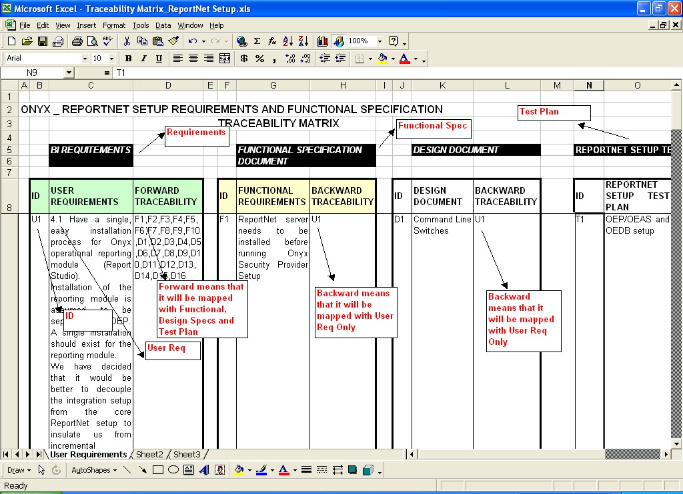

Slide 27
Configuration Management
Chapter 1

Slide 28
Configuration Management
The purpose of configuration management is to establish and maintain the integrity of the products (Components, data and documentation) of the software or system through the project and product life cycle.
Configuration Management (CM) is a "set of activities designed to control change by identifying the work products that are likely to change, establishing relationships among them, defining mechanisms for managing different versions of these work products, controlling the changes imposed, and auditing and reporting on the changes made.“

Slide 29
IMPORTANT SCM ACTIVITIES
Identifying and organizing the software configurable items
Maintaining change requests and systematically controlling the changes to the configurable items
Tracking the status of the Configurable items
Review and Audit of the software configuration management activities

Slide 30
The testers need to know two aspects of change.
The characteristics of the change so that modification to the test plan and test data can be made to assure the right functionality and structure are tested.
The version in which that change will be implemented

Slide 31
Configurable Vs Non-Configurable Items
Project may contain Configurable items(CI) as well as Non Configurable items(Non-CI)
Example for Configurable Items:
1.Test Plan
2.Test case Design
Example for Non-Configurable Items:
1.MOM
2.Weekly status report

Slide 32
Process involved in SCM
Forming SCM Team
Creating Project Library structure
Define and create User groups and Access control
Archival of Project Items

Slide 33
Forming SCM TEAM
Team which takes care of SCM Activities by creating PROJECT LIBRARY STRUCTURE
Some benefits of SCM Tool
Keep back up of all work products
Track which person changes what and when
Doesn’t allow more than one person to make modifications at the same time
Helps the Top level management to Track progress

Slide 34
Define and create User groups and Access Control
User Groups Access Control
Management Read
SCM Coordinator/PL Full Control
TL Read/Write
Team members Read/Write

Slide 35
Archival of the Project item
Maintaining Hardcopies and softcopies of the work products

Slide 36
Defect logging in identified test management tool

Slide 37
DEFECT MANAGEMENT
Defect Management
What is a defect
Types of defects
Defect life cycle
Defect reporting
Defect management
Defect management Tools

Slide 38
What is a Defect
Any non conformance is a defect
A deviation from specifications, whether missing, wrong, or extra
Anything that causes customer dissatisfactions, whether in the requirements or not

Slide 39
Types of Defect
Functionality Defects
Programming Defects
Logical Defects
Standards
Database Interface
Environmental defects

Slide 40
What is Defect Life Cycle?
Defect life cycle, also known as Bug Life cycle is the journey of a defect cycle, which a defect goes through during its lifetime.
It varies from organization to organization and also from project to project as it is governed by the software testing process and also depends upon the tools used.

Slide 41
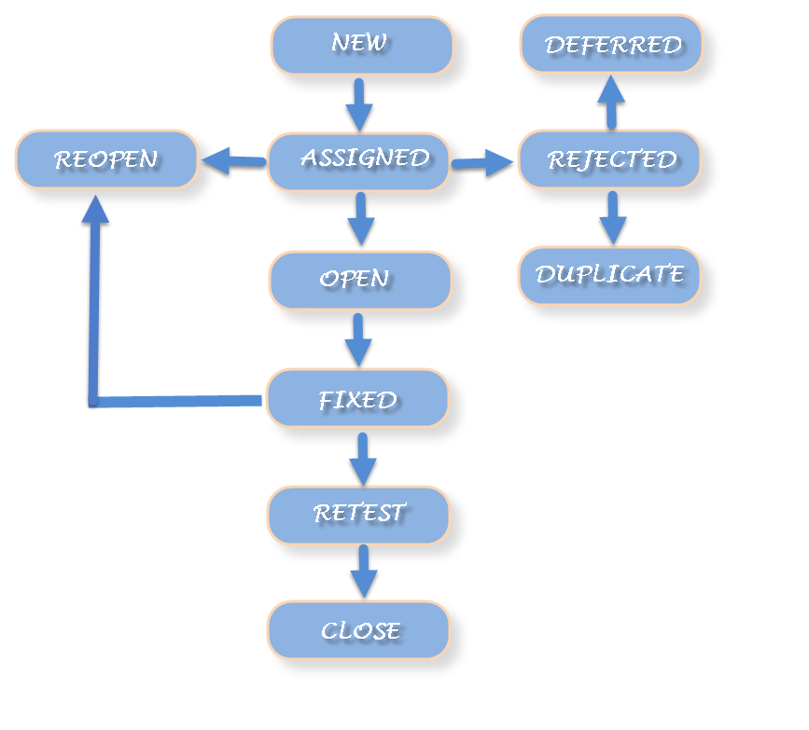

Slide 42
Defect Life Cycle includes following stages:
New: When a defect is logged and posted for the first time. Its state is given as new.
Assigned: Once the bug is posted by the tester, the lead of the tester approves the bug and assigns the bug to developer team. There can be two scenario, first that the defect can directly assign to the developer, who owns the functionality of the defect. Second, it can also be assigned to the Dev Lead and once it is approved with the Dev Lead, he or she can further move the defect to the developer.
Open: Its state when the developer starts analyzing and working on the defect fix.
Fixed: When developer makes necessary code changes and verifies the changes then he/she can make bug status as ‘Fixed’. This is also an indication to the Dev Lead that the defects on Fixed status are the defect which will be available to tester to test in the coming build.
Retest: At this stage the tester do the retesting of the changed code which developer has given to him to check whether the defect got fixed or not.
Once the latest build is pushed to the environment, Dev lead move all the Fixed defects to Retest. It is an indication to the testing team that the defects are ready to test.

Slide 43
Reopened: If the bug still exists even after the bug is fixed by the developer, the tester changes the status to “reopened”. The bug goes through the life cycle once again.
Deferred: The bug, changed to deferred state means the bug is expected to be fixed in next releases. The reasons for changing the bug to this state have many factors. Some of them are priority of the bug may be low, lack of time for the release or the bug may not have major effect on the software.
Rejected: If the developer feels that the bug is not genuine, developer rejects the bug. Then the state of the bug is changed to “rejected”.
Duplicate : If the bug is repeated twice or the two bugs mention the same concept of the bug, then the recent/latest bug status is changed to “duplicate“.
Closed: Once the bug is fixed, it is tested by the tester. If the tester feels that the bug no longer exists in the software, tester changes the status of the bug to “closed”. This state means that the bug is fixed, tested and approved.
Not a bug/Enhancement: The state given as “Not a bug/Enhancement” if there is no change in the functionality of the application. For an example: If customer asks for some change in the look and field of the application like change of color of some text then it is not a bug but just some change in the looks of the application.

Slide 44
Defect Reporting
Need for Defect Reporting:
Used to describe and quantify deviations from requirements
To correct the defect
Report the status of the application
Gather statistics used to develop defect expectations in future applications
Improve the software development process

Slide 45
Defect Reporting: Severity
Extent to which the bug will affect the system:
Very high – System Crash or loss of data
High – Functionality not available
Medium – Functions works with minor errors
Low – Cosmetic or trivial

Slide 46
TEST MODELS

Slide 47
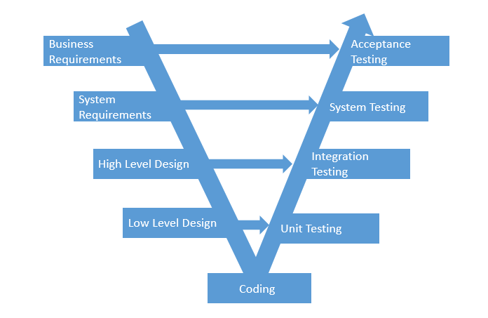
Life Cycle V- Model

Slide 48
V- Model
SDLC Phase
Test Phase
Requirements
1. Build Test Strategy.
2. Plan for Testing.
3. Acceptance Test Scenarios Identification.
Specification
System Test Case Generation.
Architecture
Integration Test Case Generation.
Detailed Design
Unit Test Case Generation

Slide 49
Queries

